Slide 1
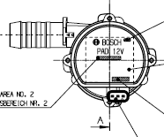
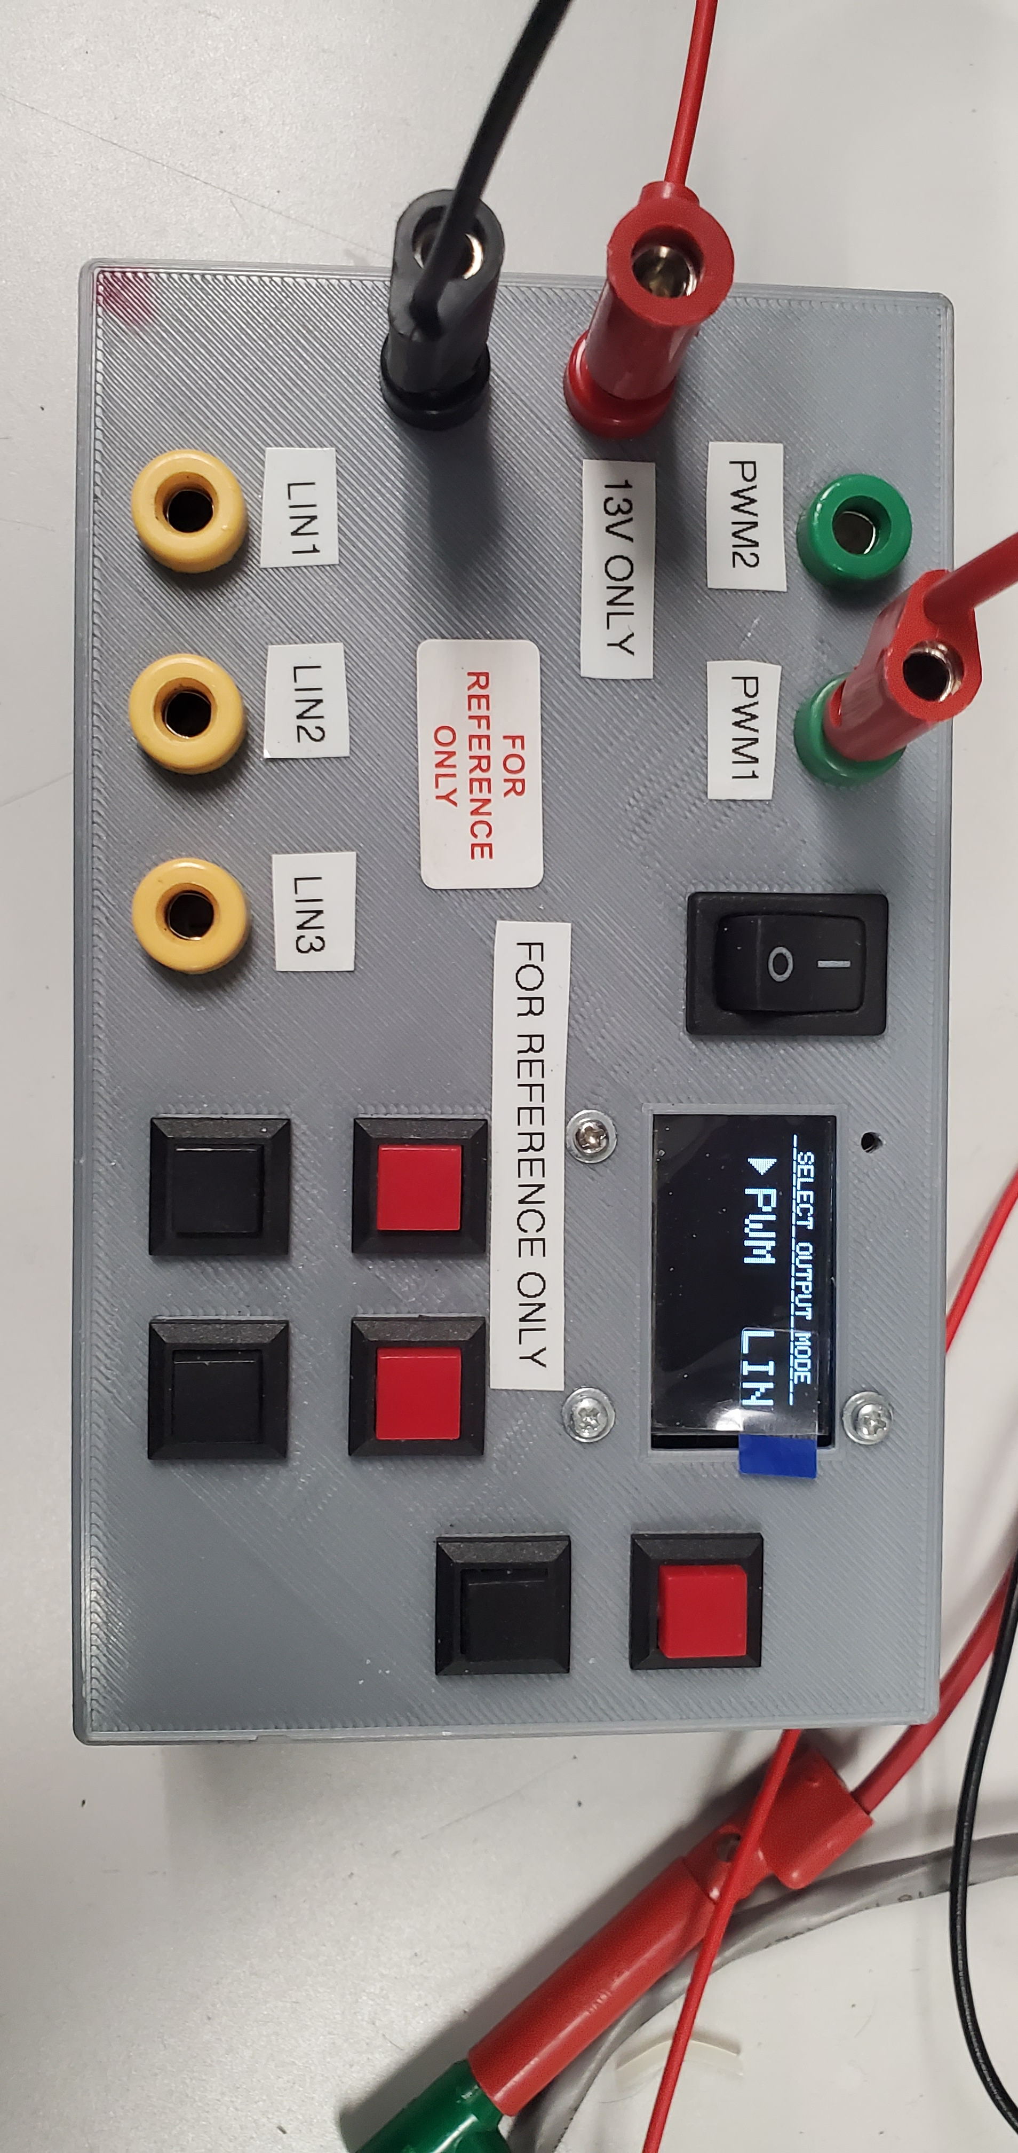
PAD2 PUMP CONNECTION DIAGRAM
OPERATING THE PAD2 PUMP WITH PWM/LIN BOX
PAD2 PUMP
PAD2 PUMP CONNECTION DIAGRAM
12V Power Supply
+
-

Slide 2
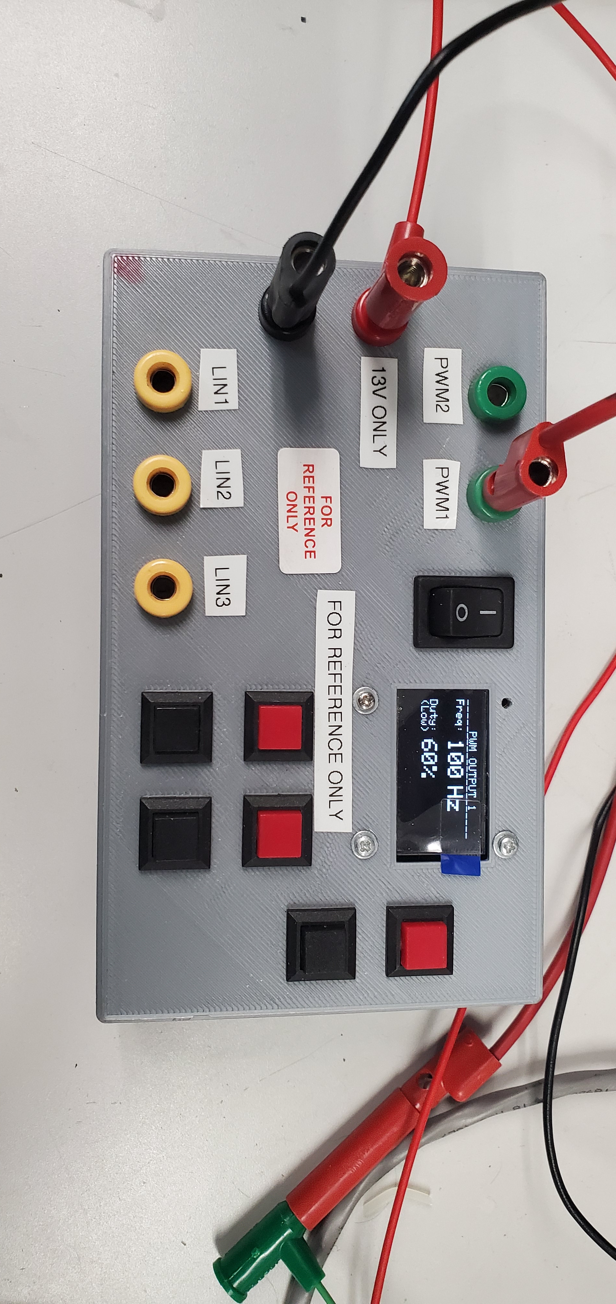
1. INITIAL POWER ON STATE →
2. Click red button upper right to enter PWM mode.
3. PWM MODE STATE →

Slide 3
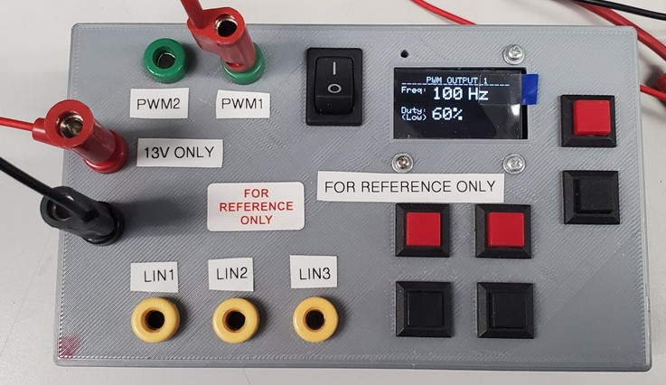
4. Adjust duty cycle percentage up (red) and down (black).

Slide 4
Other functions of the PWM/LIN Box in PWM Mode (for reference)
Not used.
Not used.
Activates sleep mode.
These adjust the frequency up (red) and down (black). Should not be needed to run pump.
Not used.
Side ports on box are also not used.

